Slide 1

File Reading
Chris Piech
CS106A, Stanford University

Slide 2
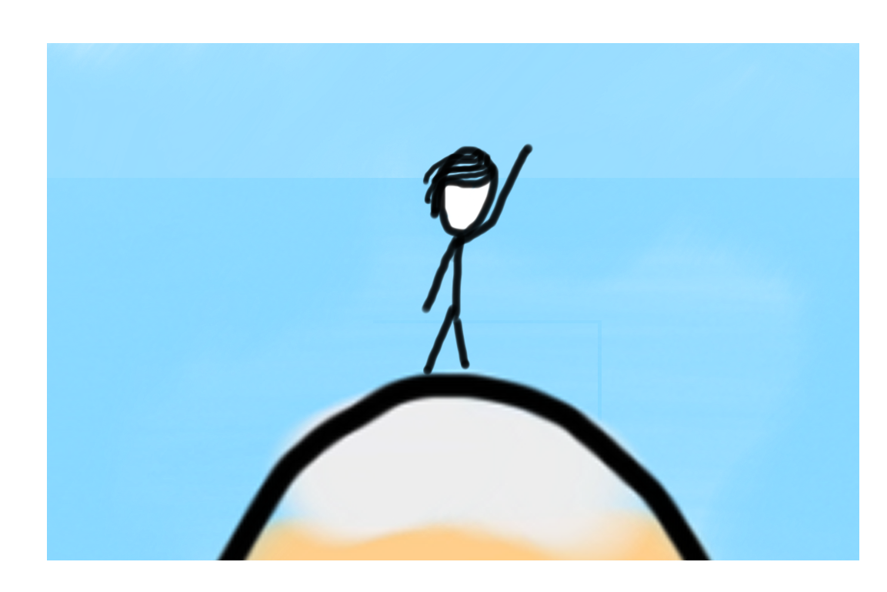
Learning Goals
1. Know how to read a file line by line.

Slide 3
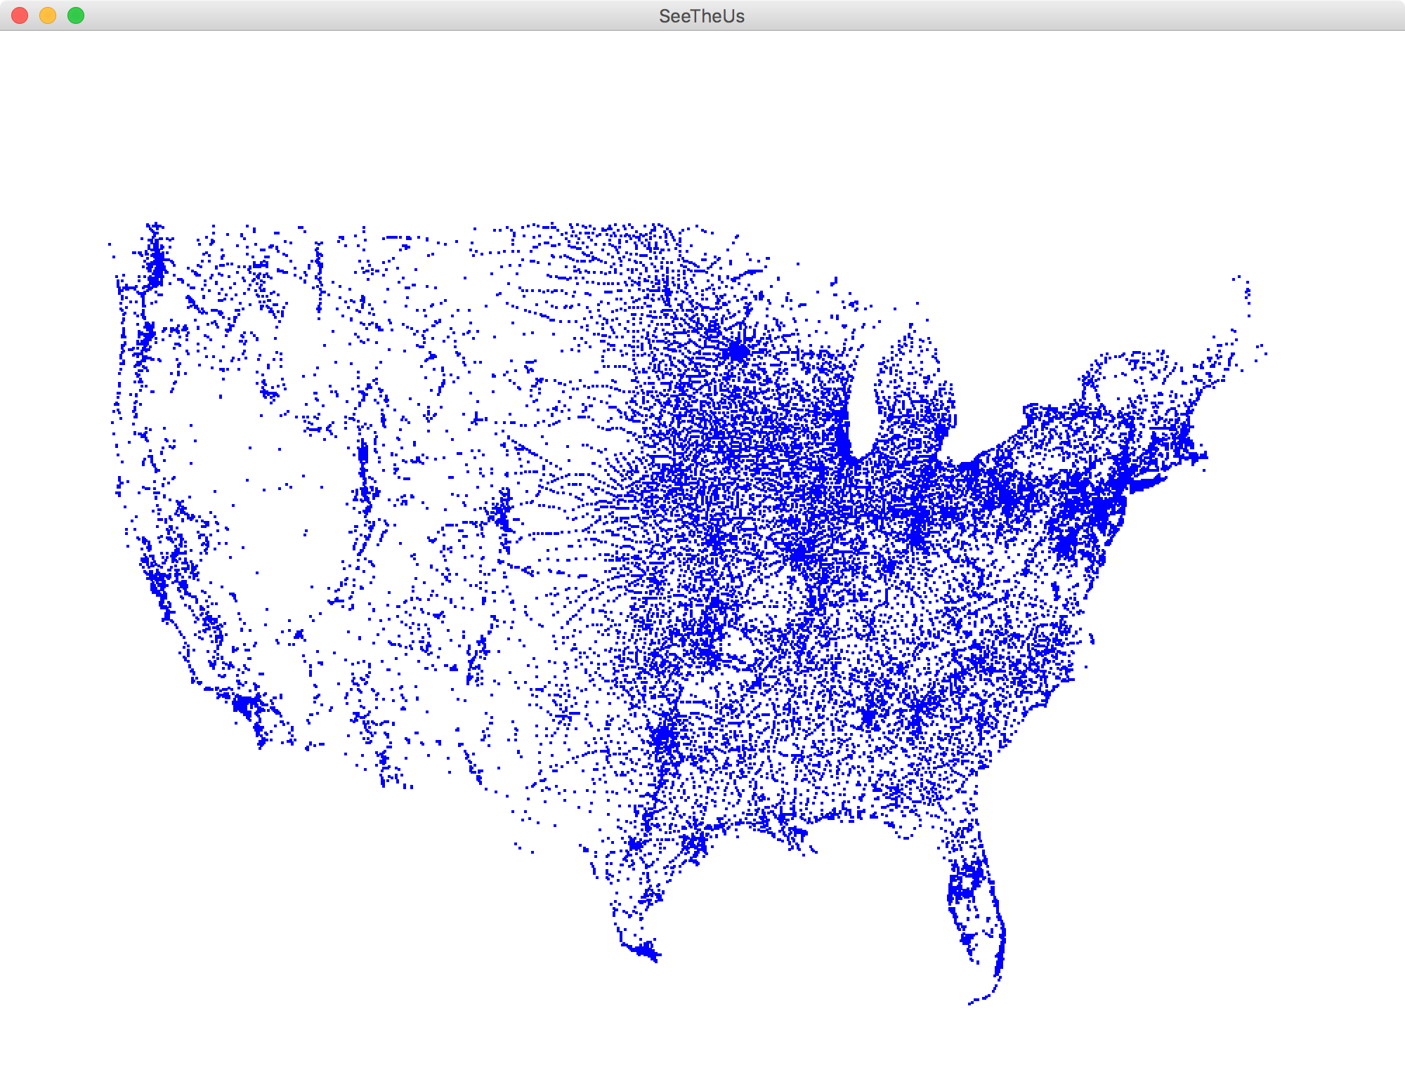
Each blue dot is a tiny GRect

Slide 4

Chris’ Favorite Program
Bright Simons

Slide 5
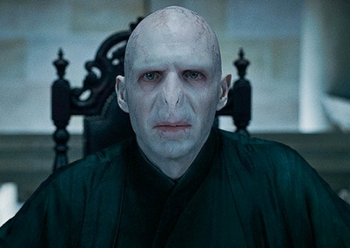
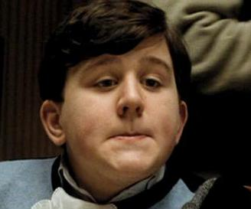

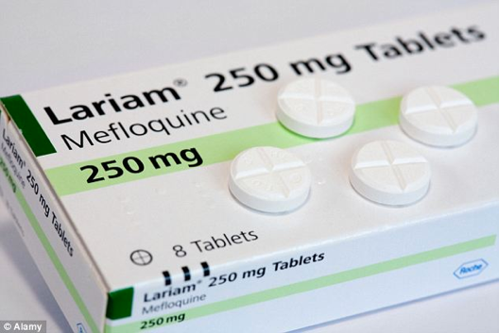
Underlying Puzzle
Counterfeiter
User
You (Distributor)

Slide 6
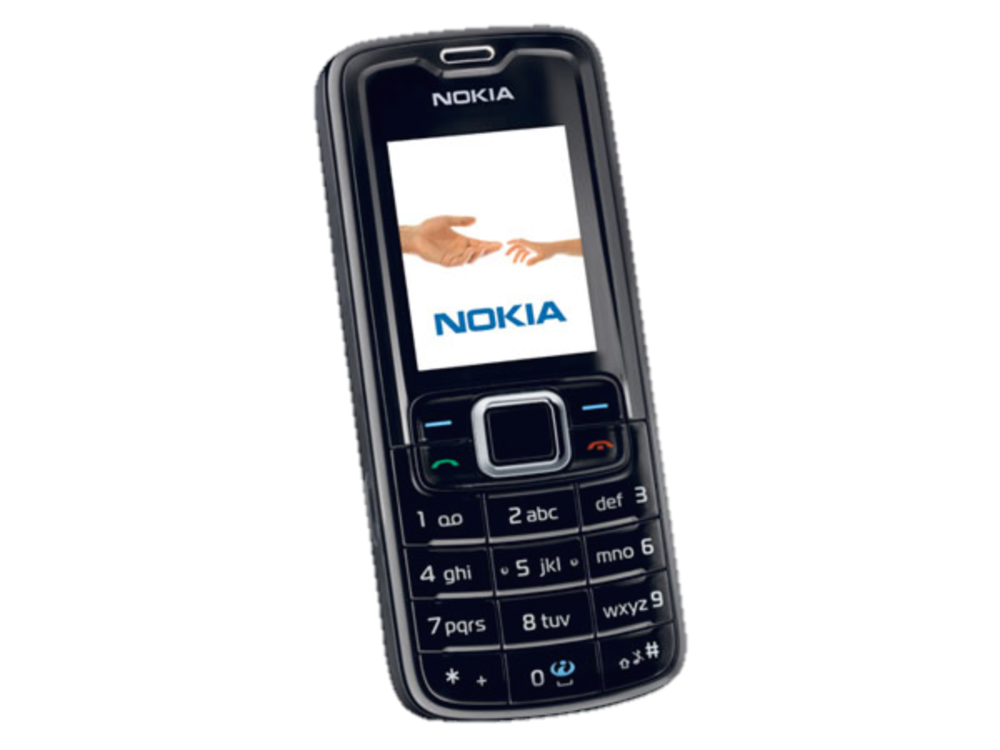
Underlying Puzzle
Counterfeiter
?
User
You (Distributor)

Slide 7
Make a code to
put on every box

Slide 9
1. Unique
2. Impossible to guess

Slide 10
Insight
So that it is impossible to guess
Concatenation
Code
=
RandomNum
+
UniqueNum
So that no two codes are the same

Slide 11
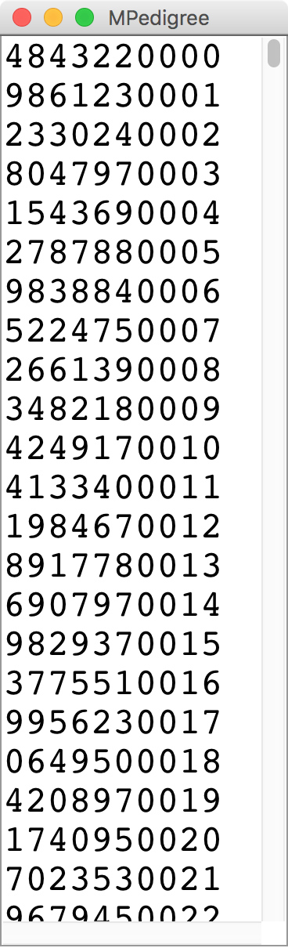
M-Pedigree

Slide 12
How strings are represented
public void run() {
String text = “hello!”;
}
H
e
l
l
o
!
0
1
2
3
4
5

Slide 13
How it is actually stored
public void run() {
String text = “hello!”;
}
stack
heap?
run
28
text
28
Length: 6
H
e
l
l
o
!

Slide 14
H
e
l
l
o
!
0
1
2
3
4
5
text.charAt(index)

Slide 15
First try
original == reverse
What went wrong?

Slide 16
private boolean isPalindrome(String original) {
String reversed = reverse(original);
return reversed == original;
}
stack
heap
isPalindrome
28
original
28
a
b
b
a
reversed
92
92
a
b
b
a

Slide 17
Use .equals to compare strings, not ==

Slide 18
ATGCTTAAACC..

Slide 19
Human Genome Project
"ATGCCAGGAC"
"GGACTTACATTTTT"
"ATTTTTGGCCGGCC"
The human genome has 3 billion base pairs

Slide 20
Compose Problem
strand1
"GCATCAT"
strand2
"CATTAC"
result
"GCATCATTAC"
The human genome has 3 billion base pairs

Slide 21
Ha. Gene was working on
The Genome project ☺
Did Gene Myers define all those little pieces as constants?

Slide 22
File Processing!
Thanks Keith Schwarz for some great slides to build off!

Slide 23
Getting Data into Programs
Put it directly in the program:
Define constants holding your values.
Get it from the user:
Mouse events, nextLine, etc.
Generate it randomly:
Use a RandomGenerator.
Get it from an external source.
Store it in a file and read it later.
Notes:
Use the example of entering a one-billion-base-pair DNA sequence into a program.

Slide 24
Reading Fiels
Virtually all programs that you've used at some point read files from disk:
Word processing (documents)
Web browser (cookies)
Games (saved progress)
Eclipse (Java files)
Music player (songs)

Slide 25
The structure of files
A file is just a series of bits (ones and zeros).
Those bits can have structure:
Plain-text: Bits represent characters.
JPEG: Bits encode information about the structure of an image.
MP3: Bits encode frequency information about music.
etc.

Slide 26
The structure of files
A file is just a series of bits (ones and zeros).
Those bits can have structure:
Plain-text: Bits represent characters.
JPEG: Bits encode information about the structure of an image.
MP3: Bits encode frequency information about music.
etc.

Slide 27
Yesterday, upon the stair,
I met a man who wasn’t there
He wasn’t there again today
I wish, I wish he’d go away...
- Hughes Mearns, "Antagonish"

Slide 28
Yesterday, upon the stair,
I met a man who wasn’t there
He wasn’t there again today
I wish, I wish he’d go away...
- Hughes Mearns, "Antagonish"
Step one:
Open the file for reading.

Slide 29
Reading in a File
Yesterday, upon the stair,
I met a man who wasn’t there
He wasn’t there again today
I wish, I wish he’d go away...
- Hughes Mearns, "Antagonish"
Scanner input = new Scanner(new File("mydata.txt"));

Slide 30
Reading in a File
Yesterday, upon the stair,
I met a man who wasn’t there
He wasn’t there again today
I wish, I wish he’d go away...
- Hughes Mearns, "Antagonish"
Scanner input = new Scanner(new File("mydata.txt"));
import java.util.*; // for Scanner
import java.io.*; // for File

Slide 31
Reading in a File
Yesterday, upon the stair,
I met a man who wasn’t there
He wasn’t there again today
I wish, I wish he’d go away...
- Hughes Mearns, "Antagonish"
Scanner input = new Scanner(new File("mydata.txt"));
Step Two:
Read the file, one line at a time.

Slide 32
Reading in a File
Yesterday, upon the stair,
I met a man who wasn’t there
He wasn’t there again today
I wish, I wish he’d go away...
- Hughes Mearns, "Antagonish"
Scanner input = new Scanner(new File("mydata.txt"));
// Yesterday, upon the stair
String line1 = input.nextLine();

Slide 33
Reading in a File
Yesterday, upon the stair,
I met a man who wasn’t there
He wasn’t there again today
I wish, I wish he’d go away...
- Hughes Mearns, "Antagonish"
Scanner input = new Scanner(new File("mydata.txt"));
// Yesterday, upon the stair
String line1 = input.nextLine();

Slide 34
Reading in a File
Yesterday, upon the stair,
I met a man who wasn’t there
He wasn’t there again today
I wish, I wish he’d go away...
- Hughes Mearns, "Antagonish"
Scanner input = new Scanner(new File("mydata.txt"));
// Yesterday, upon the stair
String line1 = input.nextLine();
// I met a man who wasn't there
String line2 = input.nextLine();
Notes:
Forgets past lines! (Gumball machine)

Slide 35
Reading in a File
Yesterday, upon the stair,
I met a man who wasn’t there
He wasn’t there again today
I wish, I wish he’d go away...
- Hughes Mearns, "Antagonish"
Scanner input = new Scanner(new File("mydata.txt"));
// "Yesterday, upon the stair"
String line1 = input.nextLine();
// I met a man who wasn't there
String line2 = input.nextLine();

Slide 36
Reading in a File
Yesterday, upon the stair,
I met a man who wasn’t there
He wasn’t there again today
I wish, I wish he’d go away...
- Hughes Mearns, "Antagonish"
Scanner input = new Scanner(new File("mydata.txt"));
...
// He wasn't there again today
String line3 = input.nextLine();

Slide 37
Reading in a File
Yesterday, upon the stair,
I met a man who wasn’t there
He wasn’t there again today
I wish, I wish he’d go away...
- Hughes Mearns, "Antagonish"
Scanner input = new Scanner(new File("mydata.txt"));
...
// He wasn't there again today
String line3 = input.nextLine();

Slide 38
Reading in a File
Yesterday, upon the stair,
I met a man who wasn’t there
He wasn’t there again today
I wish, I wish he’d go away...
- Hughes Mearns, "Antagonish"
Scanner input = new Scanner(new File("mydata.txt"));
...
// He wasn't there again today
String line3 = input.nextLine();
// I wish, I wish he'd go away
String line4 = input.nextLine();

Slide 39
Reading in a File
Yesterday, upon the stair,
I met a man who wasn’t there
He wasn’t there again today
I wish, I wish he’d go away...
- Hughes Mearns, "Antagonish"
Scanner input = new Scanner(new File("mydata.txt"));
...
// He wasn't there again today
String line3 = input.nextLine();
// I wish, I wish he'd go away
String line4 = input.nextLine();

Slide 40
Reading in a File
Yesterday, upon the stair,
I met a man who wasn’t there
He wasn’t there again today
I wish, I wish he’d go away...
- Hughes Mearns, "Antagonish"
Scanner input = new Scanner(new File("mydata.txt"));
...
// - Hughes Mearns, "Antagonish"
String line5 = input.nextLine();

Slide 41
Reading in a File
Yesterday, upon the stair,
I met a man who wasn’t there
He wasn’t there again today
I wish, I wish he’d go away...
- Hughes Mearns, "Antagonish"
Scanner input = new Scanner(new File("mydata.txt"));
...
// - Hughes Mearns, "Antagonish"
String line5 = input.nextLine();

Slide 42
Reading in a File
Yesterday, upon the stair,
I met a man who wasn’t there
He wasn’t there again today
I wish, I wish he’d go away...
- Hughes Mearns, "Antagonish"
Scanner input = new Scanner(new File("mydata.txt"));
...
// - Hughes Mearns, "Antagonish"
String line5 = input.nextLine();
Notes:
But what if we don’t know the number of lines!

Slide 43
Reading in a File
Yesterday, upon the stair,
I met a man who wasn’t there
He wasn’t there again today
I wish, I wish he’d go away...
- Hughes Mearns, "Antagonish"
Scanner input = new Scanner(new File("mydata.txt"));
...
// prints all lines in the file
while (input.hasNextLine()) {
String line = input.nextLine();
println(line);
}

Slide 44
Reading in a File
Yesterday, upon the stair,
I met a man who wasn’t there
He wasn’t there again today
I wish, I wish he’d go away...
- Hughes Mearns, "Antagonish"
Scanner input = new Scanner(new File("mydata.txt"));
...
// prints all lines in the file
while (input.hasNextLine()) {
String line = input.nextLine();
println(line);
}
Step Three: close the file.

Slide 45
Reading in a File
Yesterday, upon the stair,
I met a man who wasn’t there
He wasn’t there again today
I wish, I wish he’d go away...
- Hughes Mearns, "Antagonish"
Scanner input = new Scanner(new File("mydata.txt"));
...
// prints all lines in the file
while (input.hasNextLine()) {
String line = input.nextLine();
println(line);
}
input.close();

Slide 46
Scanner Methods
Method | Description
sc.nextLine() | reads and returns a one-line String from the file
sc.next() | reads and returns a one-word String from the file
sc.nextInt() | reads and returns an int from the file
sc.nextDouble() | reads and returns a double from the file
sc.hasNextLine() | returns true if there are any more lines
sc.hasNext() | returns true if there are any more tokens
sc.hasNextInt() | returns true if there is a next token and it's an int
sc.hasNextDouble() | returns true if there is a next token and it's a double
sc.close(); | should be called when done reading the file

Slide 47
Let “try” it out!
Thanks Keith Schwarz for some great slides to build off!

Slide 48
There’s a “catch”
Thanks Keith Schwarz for some great slides to build off!

Slide 49
Sometimes things break
Programs sometimes encounter unexpected errors.
Sometimes these are bugs:
Dividing by zero.
Sending a message to a null object.
Sometimes these are due to external factors:
Network errors.
Missing files.

Slide 50
Exceptional cases
If Java encounters a case where it can't proceed as normal, it will cause an exception.
Java requires that your program handle certain types of exceptions.
Think of exceptions as rerouting control in an emergency:
If all goes well, program continues as usual.
If something goes wrong, handle the emergency.

Slide 51
Let “try” it out!
Thanks Keith Schwarz for some great slides to build off!

Slide 52
Let try it out!
Thanks Keith Schwarz for some great slides to build off!

Slide 53
try-ing your best
To use a method or class that might cause an exception, you need to tell Java to try its best, knowing that it might fail.

Slide 54
try-ing your best
To use a method or class that might cause an exception, you need to tell Java to try its best, knowing that it might fail.
try {
Scanner input =
new Scanner(new File("poem.txt"));
String line1 = input.nextLine(); // Yesterday, upon the stair,
String line2 = input.nextLine(); // I met a man who wasn't there
String line3 = input.nextLine(); // He wasn't there again today
String line4 = input.nextLine(); // I wish, I wish he'd go away...
String line5 = input.nextLine(); // - Hughes Mearns, "Antagonish"
String line6 = input.nextLine(); // *Returns null*
input.close();
}

Slide 55
try-ing your best
To use a method or class that might cause an exception, you need to tell Java to try its best, knowing that it might fail.
try {
Scanner input =
new Scanner(new File("poem.txt"));
String line1 = input.nextLine(); // Yesterday, upon the stair,
String line2 = input.nextLine(); // I met a man who wasn't there
String line3 = input.nextLine(); // He wasn't there again today
String line4 = input.nextLine(); // I wish, I wish he'd go away...
String line5 = input.nextLine(); // - Hughes Mearns, "Antagonish"
String line6 = input.nextLine(); // *Returns null*
input.close();
}

Slide 56
There’s a “catch”
Thanks Keith Schwarz for some great slides to build off!

Slide 57
There’s a catch
Thanks Keith Schwarz for some great slides to build off!

Slide 58
try and catch me
If an exception occurs, you may need to tell Java to catch that exception.

Slide 59
try and catch me
If an exception occurs, you may need to tell Java to catch that exception.
try {
Scanner input =
new Scanner(new File("poem.txt"));
String line1 = input.nextLine(); // Yesterday, upon the stair,
String line2 = input.nextLine(); // I met a man who wasn't there
String line3 = input.nextLine(); // He wasn't there again today
String line4 = input.nextLine(); // I wish, I wish he'd go away...
String line5 = input.nextLine(); // - Hughes Mearns, "Antagonish"
String line6 = input.nextLine(); // *Returns null*
input.close();
}

Slide 60
try and catch me
If an exception occurs, you may need to tell Java to catch that exception.
try {
Scanner input =
new Scanner(new File("poem.txt"));
String line1 = input.nextLine(); // Yesterday, upon the stair,
String line2 = input.nextLine(); // I met a man who wasn't there
String line3 = input.nextLine(); // He wasn't there again today
String line4 = input.nextLine(); // I wish, I wish he'd go away...
String line5 = input.nextLine(); // - Hughes Mearns, "Antagonish"
String line6 = input.nextLine(); // *Returns null*
input.close();
} catch (IOException e) {
println("An error occurred: " + e);
}

Slide 61
try and catch me
If an exception occurs, you may need to tell Java to catch that exception.
If something
fails up here…
try {
Scanner input =
new Scanner(new File("poem.txt"));
String line1 = input.nextLine(); // Yesterday, upon the stair,
String line2 = input.nextLine(); // I met a man who wasn't there
String line3 = input.nextLine(); // He wasn't there again today
String line4 = input.nextLine(); // I wish, I wish he'd go away...
String line5 = input.nextLine(); // - Hughes Mearns, "Antagonish"
String line6 = input.nextLine(); // *Returns null*
input.close();
} catch (IOException e) {
println("An error occurred: " + e);
}

Slide 62
try and catch me
If an exception occurs, you may need to tell Java to catch that exception.
If something
fails up here…
try {
Scanner input =
new Scanner(new File("poem.txt"));
String line1 = input.nextLine(); // Yesterday, upon the stair,
String line2 = input.nextLine(); // I met a man who wasn't there
String line3 = input.nextLine(); // He wasn't there again today
String line4 = input.nextLine(); // I wish, I wish he'd go away...
String line5 = input.nextLine(); // - Hughes Mearns, "Antagonish"
String line6 = input.nextLine(); // *Returns null*
input.close();
} catch (IOException e) {
println("An error occurred: " + e);
}
… we immediately jump down here.

Slide 63
try and catch me
If an exception occurs, you may need to tell Java to catch that exception.
If something
fails up here…
try {
Scanner input =
new Scanner(new File("poem.txt"));
String line1 = input.nextLine(); // Yesterday, upon the stair,
String line2 = input.nextLine(); // I met a man who wasn't there
String line3 = input.nextLine(); // He wasn't there again today
String line4 = input.nextLine(); // I wish, I wish he'd go away...
String line5 = input.nextLine(); // - Hughes Mearns, "Antagonish"
String line6 = input.nextLine(); // *Returns null*
input.close();
} catch (IOException e) {
throw new RuntimeException(e);
}
… we immediately jump down here.

Slide 64
File concepts in one slide
Make a Scanner (lets call it input) to open a file for reading
Use scanner.nextLine to get one line from the file
Both the above operations are “dangerous” so we need to use a try/catch loop
You can either handle the problem or throw a runtime exception
Scanner input = new Scanner(new File("poem.txt"));
input.nextLine(); // returns the next line
try{
// live dangerously
} catch (Exception e){
// have heath insurance
}
throw new RuntimeException(“AHHHH!”);

Slide 65
lets throw it all together.
Thanks Keith Schwarz for some great slides to build off!

Slide 66
The classic file reading program.
The idiomatic “read all the lines of a file” code is shown here:
try {
Scanner input = /*…open the file… */
while (input.hasNextLine()) {
String line = input.nextLine();
/* … process current line … */
}
input.close();
} catch (IOException e) {
throw new RuntimeException(e);
}
Understanding this code is about 95% of what we want you to know for files in CS106A

Slide 67
US Census Data
Thanks Keith for the cool dataset

